Slide 1


Indian Health Service
Portland Area Director’s Update
Dean M Seyler - Area Director
October 16, 2012
Quarterly Board Meeting
Skagit Valley Casino Resort

Slide 2



Congratulations to the NPAIHB for 40 years of advocacy for the Northwest Tribes. The NPAIHB sets the pace for others to emulate.
On behalf of the Portland Area Indian Health Service, I commend you all for your dedication and service to your communities.

Slide 3
Renew And Strengthen Our Partnership With Tribes
Direct Service Tribes Area Meeting
  September 25, 2012
    2005 Master Plan
  Individual Tribal Council Meetings
Urban Directors Meeting
  December/January
    Semi Annual Event

Slide 4
Renew And Strengthen Our Partnership With Tribes
2013 Injury Prevention Campaign Goals
Continued collaboration with NPAIHB and NWIHB Injury Prevention Programs
Pilot Needs Assessments in at least 2 Tribal Communities
Develop Elder Fall Prevention Program Model that Integrates Primary Care and Public Health Systems

Slide 5
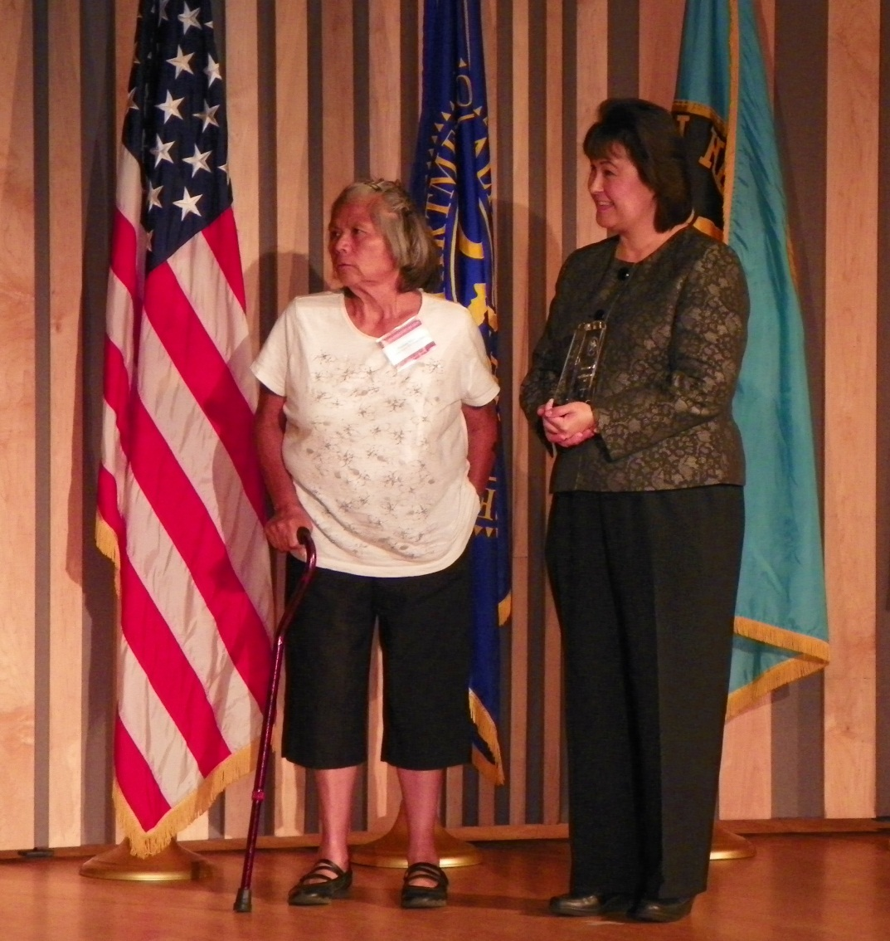
Renew And Strengthen Our Partnership With Tribes

Slide 6
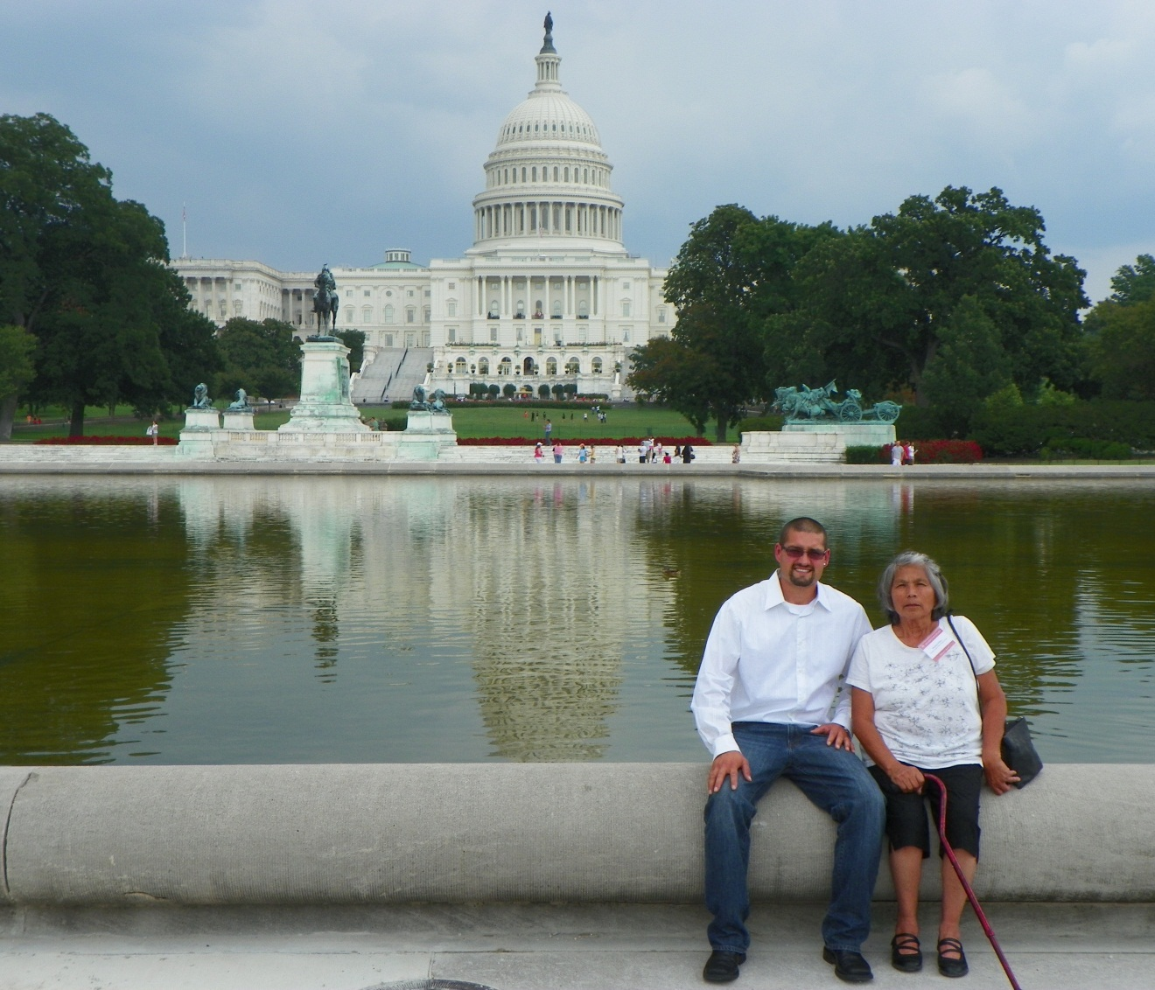
Renew And Strengthen Our Partnership With Tribes

Slide 7
Ensure that our work is transparent, accountable, fair, and inclusive
Email Steven.Poirta@ihs.gov if your name is on this list

Slide 8
To Reform The IHS
Staff Update:
  Chief Medical Officer - Portland Area – Still Vacant
  Meaningful Use Coordinator – Dr. Woody Crow
ICD-10 - Update
  19 Tribal Sites
  1 Urban Program
  All Federal Sites

Slide 9
Improve The Quality Of And Access To Care
Nespelem Dental Clinic Replacement Project
Aimed at improving access to and quality of care.
Replaces a dental clinic that was in vintage 1930’s space
Provides patients with modern dental suites. Safer and easier access to care.
Constructed by the Colville Tribes under a PL 93-638 Subpart J Construction Contract
  Constructed as an addition to the Tribal Clinic
  New space is tribally owned and leased to IHS under a 437 Lease

Slide 10
Improve The Quality Of And Access To Care
Yakama Health Center Expansion and Renovation Project
Aimed at improving access to and quality of care.
New 4,600 S.F. Institutional Support Building dedicated October 2011
Renovation of Existing Clinic (20-years old)
  Provides New Exam Rooms by relocating offices
  Provides new Pharmacy improves access and confidentiality.
  Improves patient flow as they leave their provider’s office.
  New Digital Radiology
  Heating and Cooling Problems

Slide 11
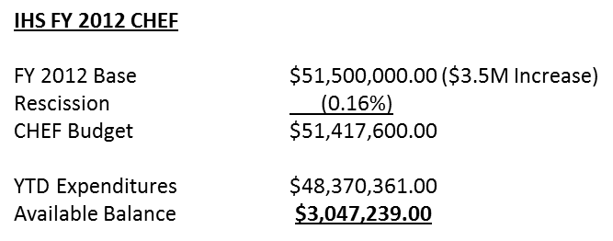
Improve The Quality Of And Access To Care
Catastrophic Health Emergency Fund
  115 CHEF cases received and Processed - $8,581,901
  Requested Reimbursement After Threshold - $3,125,786
  Received $1,931,095 for 60 cases

Slide 12
Ensure that our work is transparent, accountable, fair, and inclusive
FY 2013 Six month CR
  Through March 2013
  48.77% of the base
SFC Projects in FY2012:
  44 new projects at $9.7M total funds.
  Includes all 43 Portland Area Tribes for scattered site facilities, and
  Will serve 25 Tribes with specific facilities/services.

Slide 13
Questions or Comments?
Our Mission... to raise the physical, mental, social, and spiritual health of American Indians and Alaska Natives to the highest level.
Our Goal... to assure that comprehensive, culturally acceptable personal and public health services are available and accessible to American Indian and Alaska Native people.
Our Foundation... to uphold the Federal Government's obligation to promote healthy American Indian and Alaska Native people, communities, and cultures and to honor and protect the inherent sovereign rights of Tribes.

Slide 14
GPRA 2012
Final Results

Slide 15
2012 GPRA Results
Federal Service Units and Tribal Programs
  Met 9 out of 21 measures
    Met 4 out of 6 Diabetes Measures
    Met:
      Poor and Ideal Glycemic Control
      Ideal Glycemic Control
      LDL Assessed
      Nephropathy Assessed
    Did Not Meet:
      Controlled Blood Pressure
      Retinopathy Assessed

Slide 16
2012 GPRA Results
Federal Service Units and Tribal Programs
  Met All 3 Dental Measures
    Dental Access
    Sealants
    Topical Fluoride

Slide 17
2012 GPRA Results
Federal Service Units and Tribal Programs
  Met 1 of the 3 Immunization Measures
    Met:
      Influenza for patient 65+
    Did Not Meet:
      Pneumovax for patients 65+
      Childhood Immunizations

Slide 18
2012 GPRA Results
Federal Service Units and Tribal Programs
  Met 1 of the 4 Cancer Screening Measures
    Met:
      Colorectal Cancer Screening
    Did Not Meet:
      Pap Smear
      Mammogram
      Tobacco Cessation Counseling

Slide 19
2012 GPRA Results
Federal Service Units and Tribal Programs
  Met None of the CVD, HIV and Behavioral Health Screening Measures
    Did Not Meet:
      Alcohol Screening for FAS prevention
      Domestic Violence Screening
      Depression Screening
      Comprehensive CVD Assessment
      Prenatal HIV Testing

Slide 20
Awards
For the 1st time ever 2 sites met all
GPRA measures!!!

Slide 21
2012 GPRA Award is hereby granted to
Western Oregon Service Unit for
Meeting all 21 GPRA Measures
100%

Slide 22
2012 GPRA Award is hereby granted to
Wellpinit Service Unit for
Meeting all 21 GPRA Measures
100%

Slide 23
2012 GPRA Award is hereby granted to
Yellowhawk
Honorable Mention for
Meeting 14 of 21 GPRA Measures
66%

Slide 24
2012 GPRA Award is hereby granted to
Muckleshoot for
Receiving the National Annual GPRA Award for
Most Improved in all 3 Dental Service Measures
Access to Care – 9% Increase
Dental Sealants – 142% Increase
Topical Fluoride – 79% Increase

Slide 25
GPRA Awards
CONGRATULATIONS!

Slide 26
Changes for 2013
Continue reporting the same 21 Clinical Measures
Final 2013 Targets were released last week
Dental Sealants and Fluoride will change to a rate
Some logic changes to a few of the measures
  Presenting to the Clinical Directors at the next meeting
CRS Version 13.0 release - November 2012

Slide 27
Thank you!
Questions
Assistance
Mary.Brickell@ihs.gov
503-414-7754

